Slide 1
HTML and Dynamic HTML
Module 07 - User interaction with JavaScript

Slide 2
Prelude
In this chapter we will discuss ways for the JavaScript to interact with the webpage, and thus allow the user to influence our website directly.

Slide 3
Alert function
The first way to interact with the user in JS is using alerts.
The alert function allows us to pop up a single modular notification which includes text.
Note that alerts are intrusive and cannot be used stylized and should therefore only be used when it is critical to notify of anything.
The text sent to the alert function can be either straight up text or a variable.
The syntax for alerts is fairly simple:
alert(*text*);

Slide 4
Confirm function
A slightly more interactive form of the alert is the confirm dialog.
The confirm dialog can allow us to either confirm or cancel an action.
This can be implemented for warnings, for example for navigating to a different page on a website we do not control.
Confirm example:
var result = confirm("Are you sure you want to continue?");
if (result) {
alert("Good luck");
}
else {
alert("Thanks for staying");
}

Slide 5
Prompt function
Another dialog we will cover is the prompt dialog.
This dialog allows the user to insert his choice of text, while we can set the text for the prompt, as well as a default choice text.
prompt example:
var result = window.prompt("What would you like to eat?", "pizza");
alert("Enjoy your " + result);

Slide 6
Introduction to DOM
The Document Object Model or DOM is an API which was created in order to allow direct access to objects that are present within our document (The web page).
This allows us to directly change the webpage dynamically without breaking immersion for the user using popups.
As a result this makes web pages a lot more user friendly and interactive.
The DOM API also applies to XML documents.

Slide 7
What can the DOM be used for?
Several of the things we can use the DOM API for include:
Finding and setting the values of elements on a page.
Modifying the styles associated with elements.
Handling events for controls on a page.
Validating web pages.
Serializing and deserializing a page as an XML document.

Slide 8
Getting HTML elements
The first and most important of manipulating HTML elements is to retrieve the element itself in JavaScript.
We will be explaining some of the more frequently used ones, however there are many more which we can use.

Slide 9
getElementById()
The most obvious method of manipulating an element is to get the element directly.
Generally the function can be used from the document itself, or if we already have a parent element we can use the parent element to optimize the search.
This can be done by retrieving the element according to it’s ID attribute.
Note that ID is a unique attribute, so only one element can be retrieved.
Note that when an element is not found, null will be returned.
Usage:
var element = document.getElementById("myText");
if (element) -> It is important to check the element
{ exists before using it.
element.innerHTML = "New Text";
}
Notes:
If element is null then the if statement will result in false, thus causing the inner code block not to be executed.

Slide 10
getElementsByClassName()
Another option we can use is retrieving all elements with a specific class.
Generally the function can be used from the document itself, or if we already have a parent element we can use the parent element to optimize the search.
This can be done by retrieving the element according to it’s CSS class attribute.
Note that class is not a unique attribute, so the function will return an array of elements, even if only one is found.
Note that when an elements are not found, null will be returned.

Slide 11
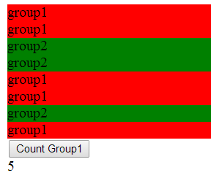
getElementsByClassName()
function count() {
var counterDiv = document.getElementById("counterDiv");
var elements = document.getElementsByClassName("group1");
counterDiv.innerHTML = elements.length + " AAA";
}
Notes:
The example above will get a DIV tag with the ID of “counterDiv”.
Then it will get all elements which has a class named “group1” (red in the picture).
Last, it will count the elements in the array created and set the length in the counterDiv element.

Slide 12
Additional getElementBy methods.
In addition to ID and Class, we can also use the following getElementsBy methods, all of which can return more then one element.
document.getElementsByName – Uses the HTML name attribute.
document.getElementsByTagName – Uses the HTML elements type (eg: div, td, input).

Slide 13
querySelector
A far more potent, although slower search method is the document.querySelector().
Instead of searching for a specific class or name we can search for any attributes, classes, and even search for controls under specific parent elements.
It will return either null if nothing was found, or the first matching element in the event of the match.
The actual search logic for this method depends on the usage of CSS selectors. It is therefore vital to know how to use CSS selectors in order to get the optimal results.

Slide 14
querySelector examples
This selector retrieves an element with the ID myElement:
var document.querySelector("#myElement");
This selector will retrieve an element with the id myElement :
var document.querySelector(".myClass");
This selector will return a div with the class myClass:
var document.querySelector("div.myClass");

Slide 15
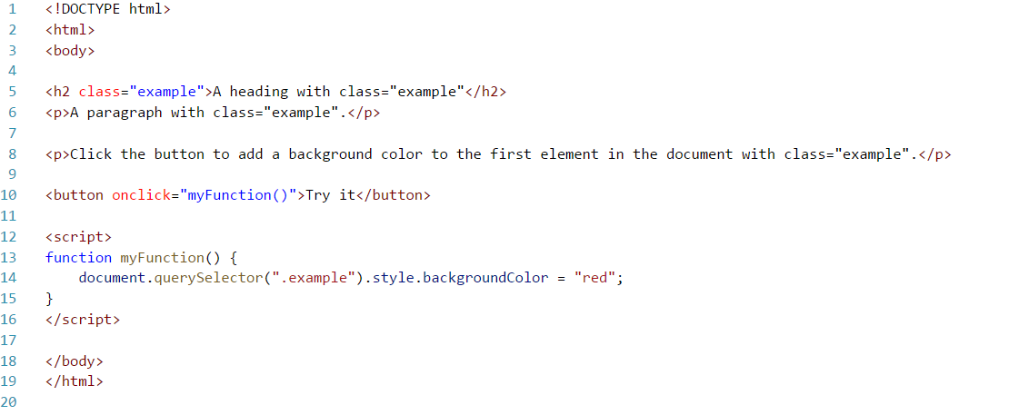
querySelector() – Code Example

Slide 16
querySelectorAll
Since document.querySelector() only returns a single result, we can use document.querySelectorAll() to return all matching elements.
This function will return an array with all matching elements, that we can then interact with.
Similarly to querySelector it also uses CSS selectors.
Can allow use of all matching elements.

Slide 17
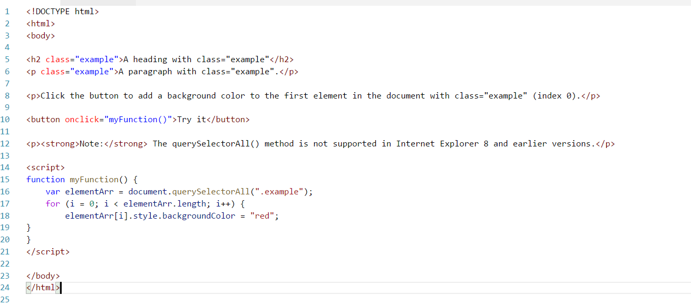
querySelectorAll() – Code Example

Slide 18
Updating an HTML element
As a general rule once we retrieved an HTML element we can then update any of their attributes and have it affect the web page itself.
We can also change the text inside them using the innerText property, or content via innerHtml.
Note that changing the content inside an element will remove any elements inside it as well.
The attributes that affect the elements will obviously depend on which attributes the element has.
Example of changing text for a div:
var myDiv = document.getElementById("myDiv");
if (myDiv){
myDiv.innerText = "This is the new text for a div.";
}

Slide 19
Updating CSS inside an element
As an additional option we can change the styling of an element or the class of an element via JS.
Examples:
Notice that changing the style directly does not cancel the class and vice versa.
var myElement = document.getElementById("myEl");
if (myElement) {
myElement.className = "group2";
myElement.setAttribute("style", "width: 300px;
background-color: yellow;");
}

Slide 20
Exercise
Create a page that presents a div that changes its color and size every few seconds.
The page will have 3 buttons: "Start", "Stop", and "Change background".
When clicking "Start " the div will start (or continue if stopped before) changing its background color.
When clicking "Stop" a confirm message should appear.
When clicking "Change background" a prompt message should appear asking the user what color to apply to the background of the div.
Perform the change of background by changing the class of the div.

Slide 21
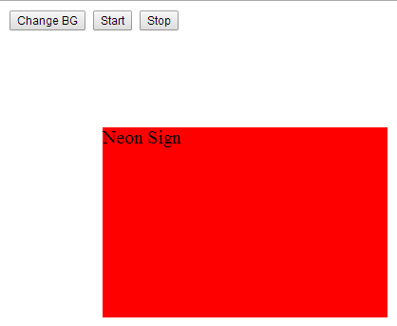
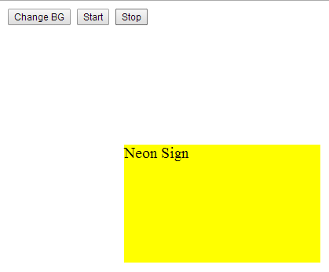
Exercise

Slide 22
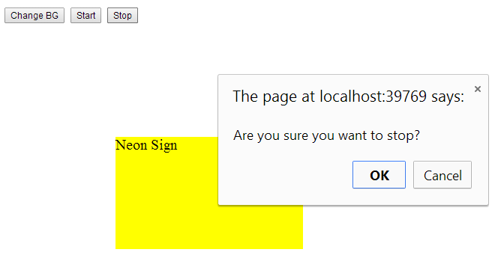
Exercise

Slide 23
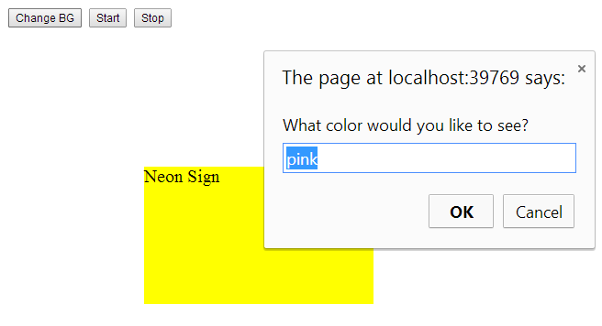
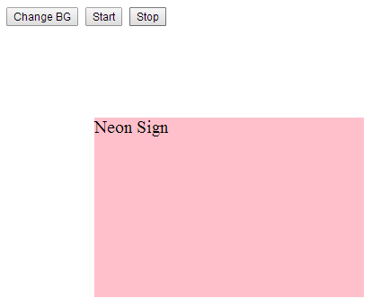
Exercise

